Slide 1
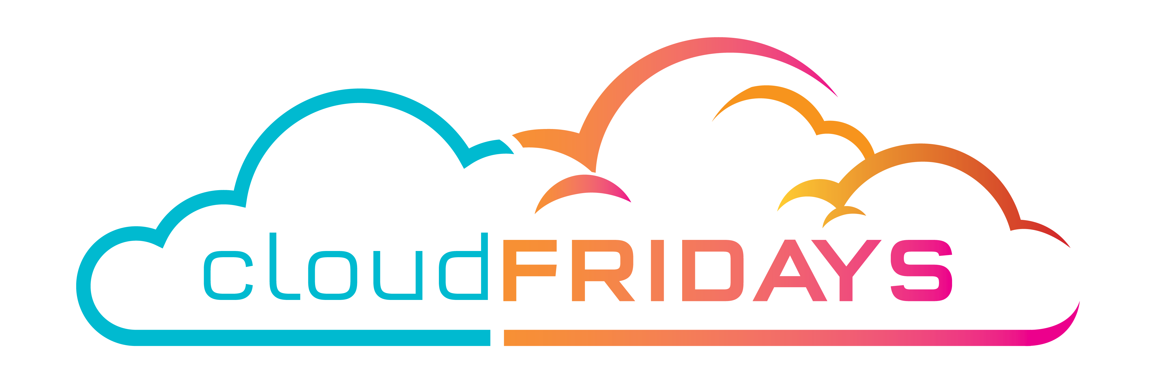

MVP Microsoft Build Watch Party
Welcome to the MVP Microsoft Build Watch Party hosted by CloudFridays. This session, Modernize applications using containers, will start at 12:00 SAST.

Slide 2
12:00 - 12:10 – Teams Dial in and casual greetings 12:10 - 12:20 - Welcome & Introduction
12:20 - 12:50 - Modernize applications using containers video playback 12:50 - 13:10 - Technical Discussion, Q&A 13:10 – 13:30 - Closing

Slide 3
Code of Conduct
Microsoft’s mission is to empower every person and every organization on the planet to achieve more. This includes all Microsoft events and gatherings, including on digital platforms, where we seek to create a respectful, friendly, fun and inclusive experience for all participants. We expect all digital event participants to uphold the principles of this Code of Conduct, which covers the main digital event and all related activities. We do not tolerate disruptive or disrespectful behaviour, messages, images, or interactions by any party participant, in any form, at any aspect of the program including business and social activities, regardless of location.
Microsoft will not tolerate harassment or discrimination based on age, ancestry, color, gender identity or expression, national origin, physical or mental disability, religion, sexual orientation, or any other characteristic protected by applicable local laws, regulations, and ordinances. We encourage everyone to assist in creating a welcoming and safe environment. Please report any concerns, harassing behavior, suspicious, or disruptive activity to Business Conduct Hotline (1-877-320-MSFT or buscond@microsoft.com). Microsoft reserves the right to refuse admittance to or remove any person from Microsoft events.

Slide 4
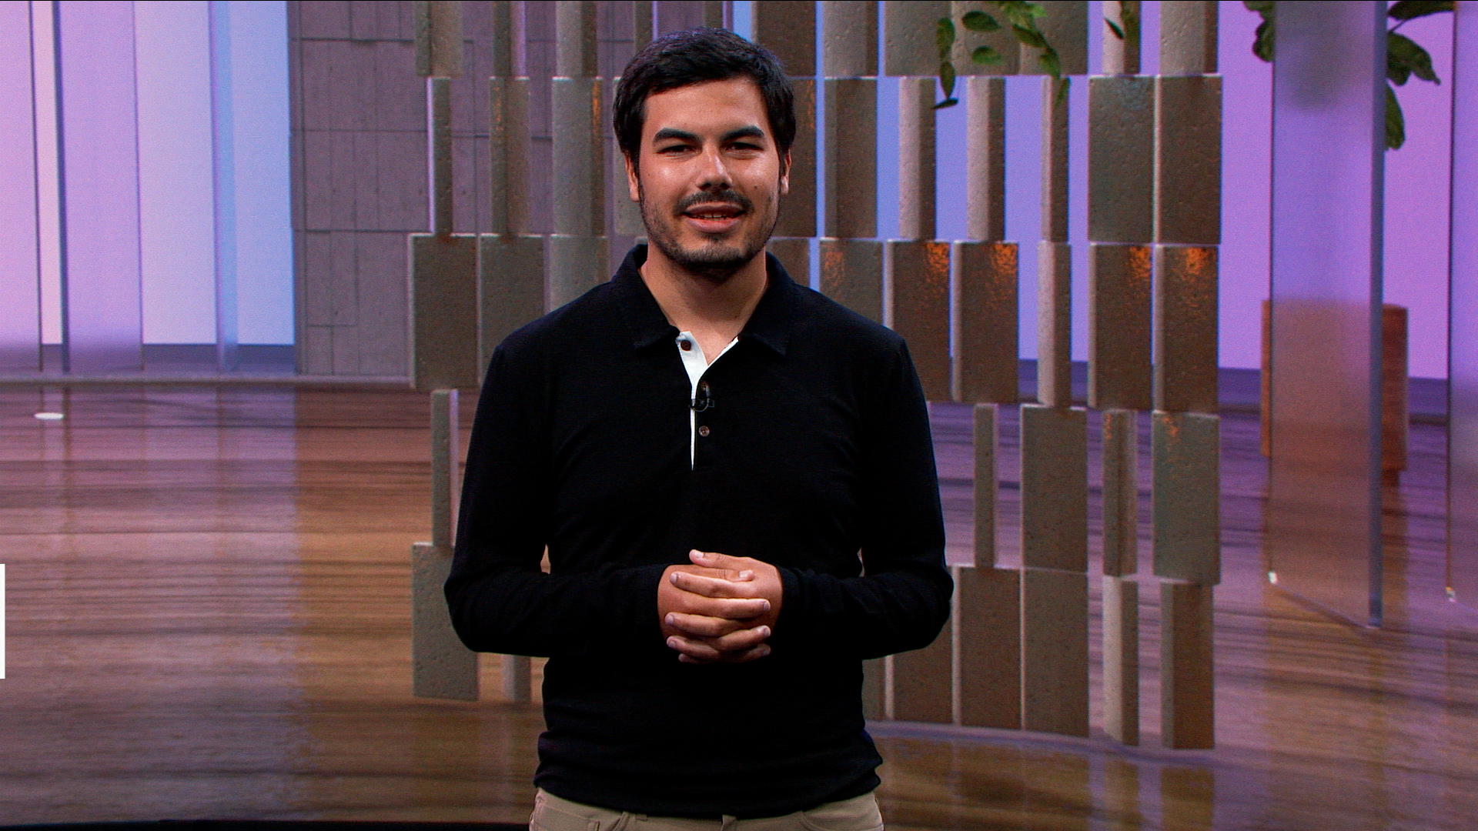
Modernize applications using containers
Speaker: Jorge Palma
Modernize applications using containers - Events | Microsoft Docs

Slide 5
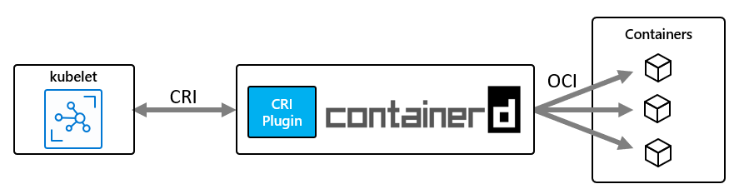
Technical Discussion, Q&A
Resources:
Watch the session online - https://docs.microsoft.com/en-us/events/build-may-2021/azure/breakouts/brk231/
Build cloud-native applications that run anywhere | Azure Blog and Updates | Microsoft Azure
Bringing Azure application services to Kubernetes with Azure Arc - Microsoft Tech Community
Azure Arc enabled Kubernetes is now Generally Available! - Microsoft Tech Community
Collections - Build2021Collections-5406 | Microsoft Docs
Public preview: AKS support for containerd for Windows server containers | Azure updates | Microsoft Azure

Slide 6
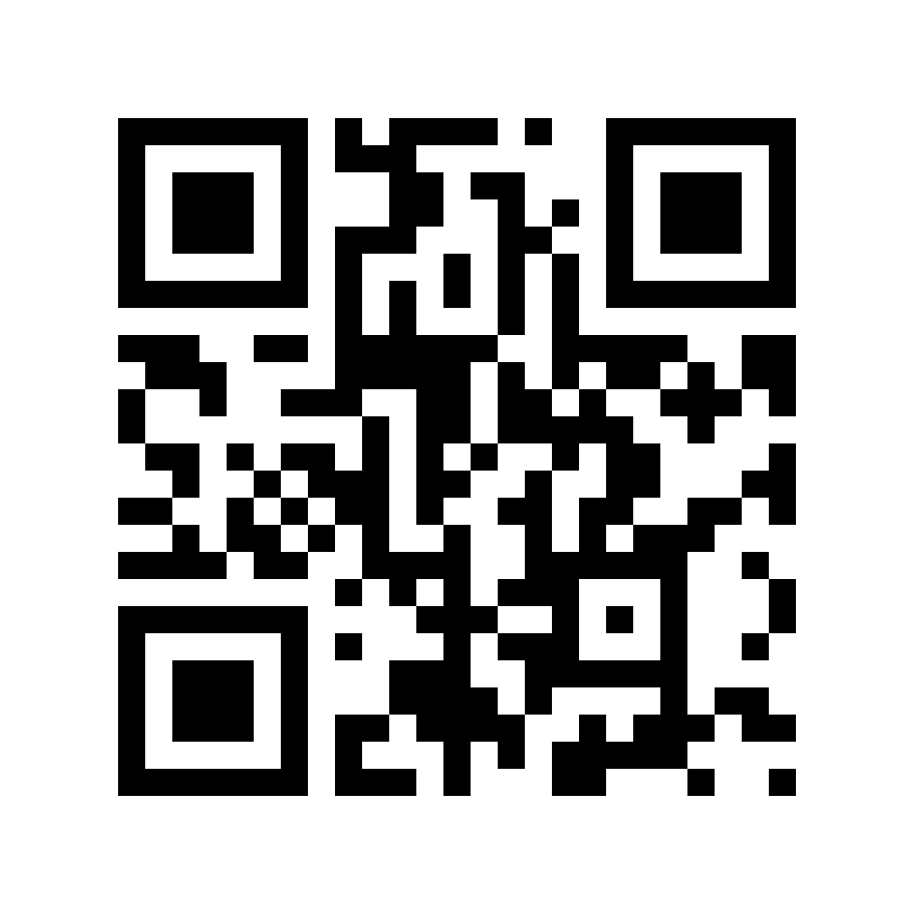
Evaluate this session
https://aka.ms/MVPMSBuildEval

